Slide 1
GCC Installation

Slide 2
On Linux
sudo apt update
sudo apt upgrade
sudo apt install build-essential
gcc --version or g++ --version

Slide 3
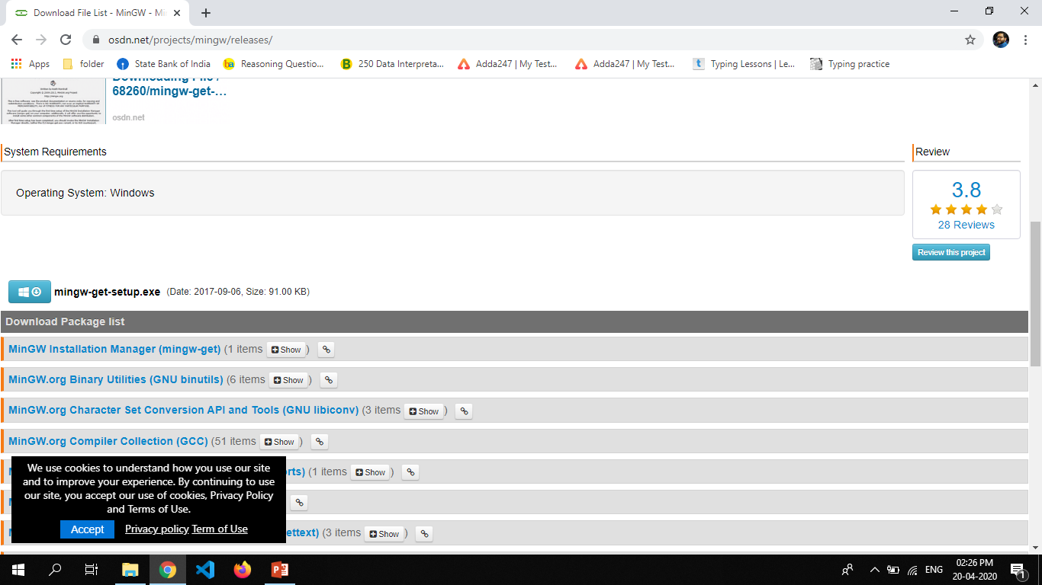
On Windows
For windows you have install MinGW software.
http://www.mingw.org/
Find download link on top right
Click on that link it will redirect you to download page
Find the download option and click on that
After that it will download online installer
Double click on that
Click here

Slide 4
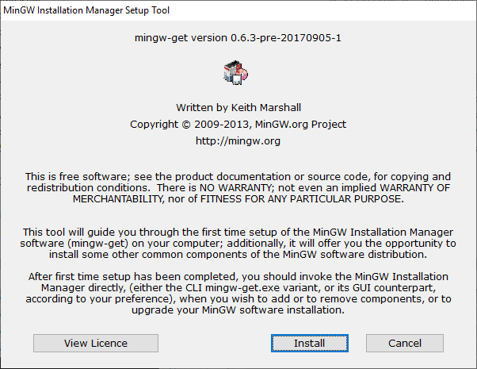
On Windows

Slide 5
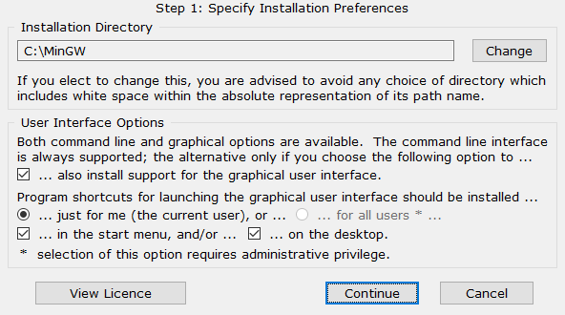
On Windows

Slide 6
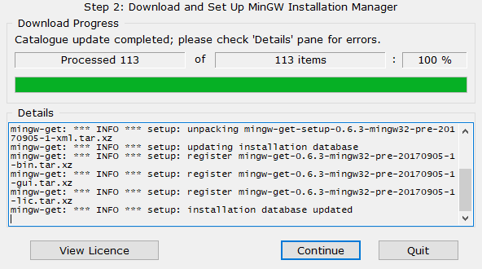
On Windows

Slide 7
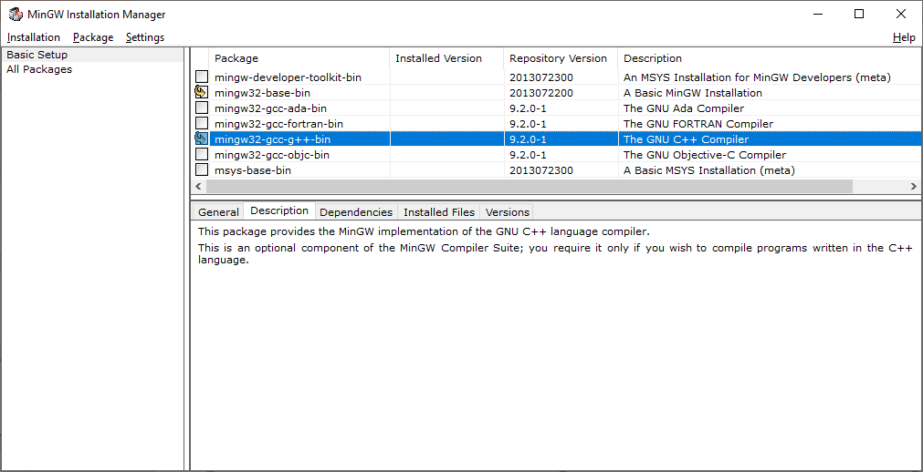
On Windows

Slide 8
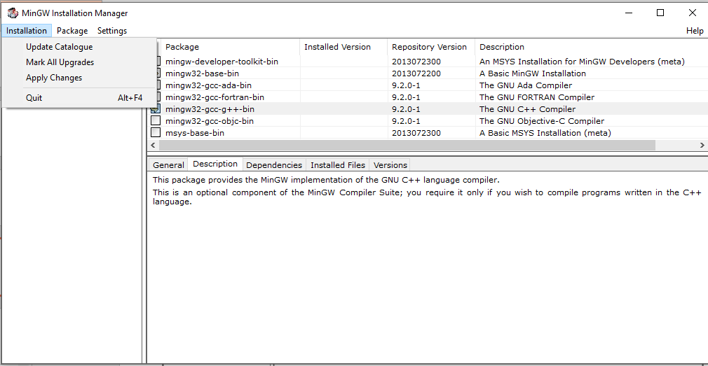
On Windows

Slide 9
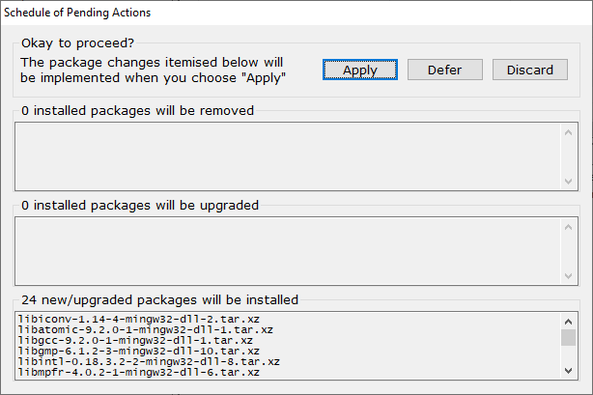
On Windows

Slide 10
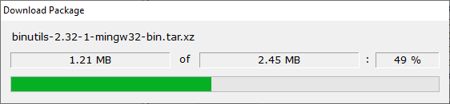
On Windows

Slide 11
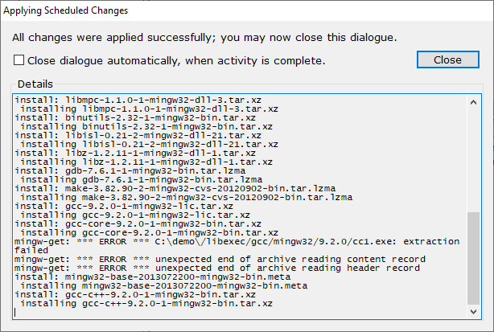
On Windows

Slide 12
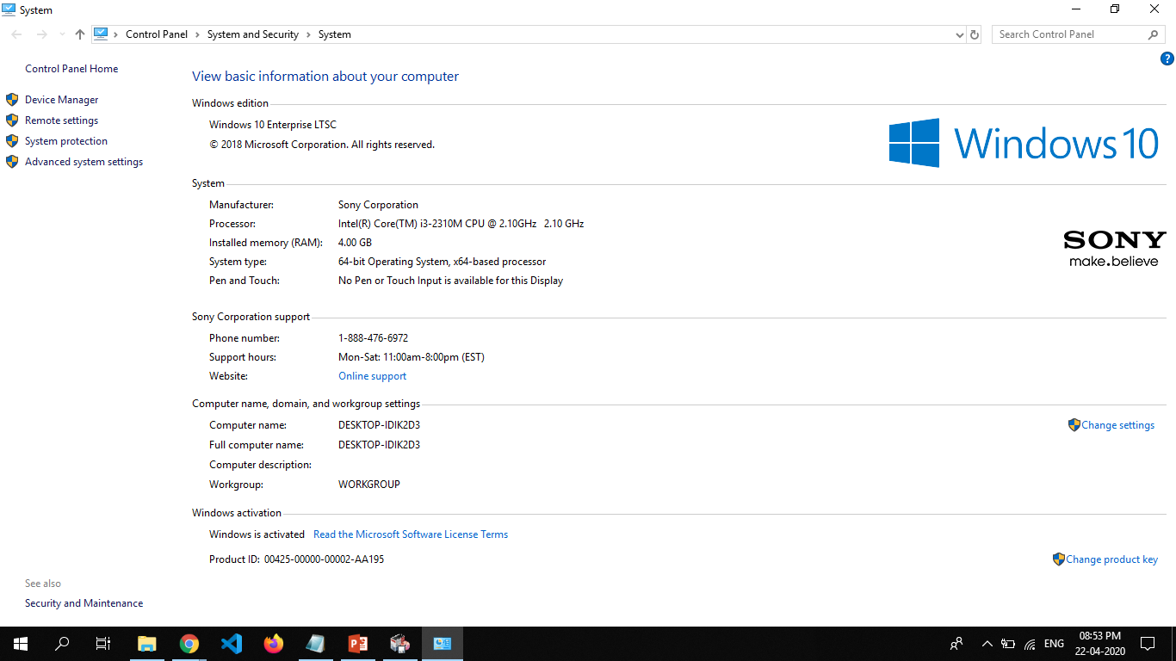
On Windows(Set Path)

Slide 13
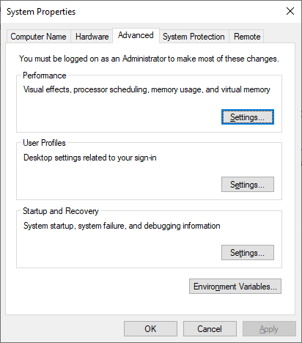
On Windows(Set Path)

Slide 14
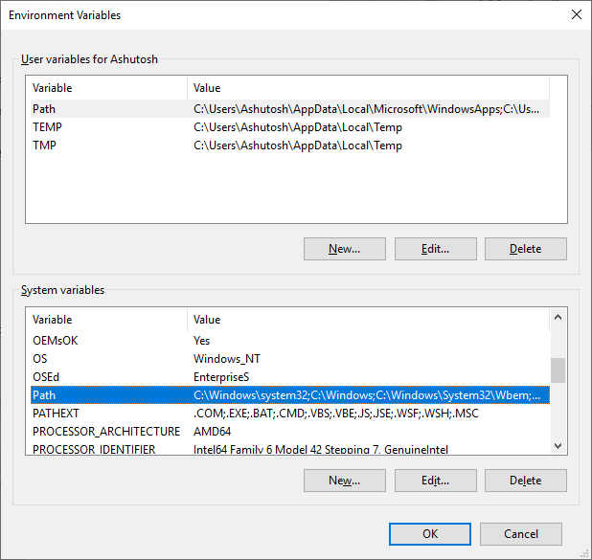
On Windows(Set Path)

Slide 15
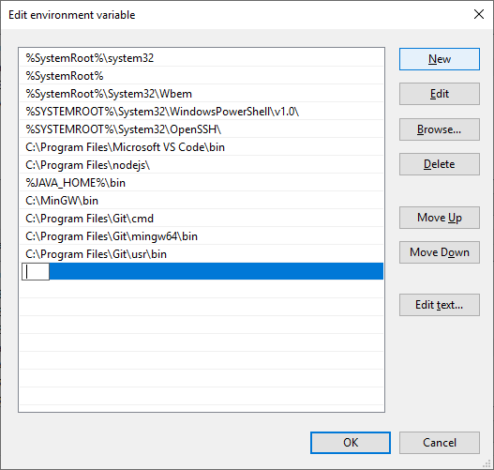
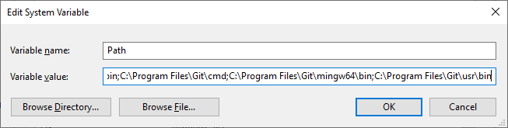
On Windows(Set Path)

Slide 16
Compilation of Program
Source Code( .c or .cpp)
g++ hello.cpp
g++ -o hello hello.cpp
Preprocessing
a.out (Linux) or a.exe(Windows)
Step1: Preprocessor
Expanded Code file( .i or .ii)
Hello.cpp
Compilation
Step2: Compiler
Assembly Code( .s)
Assemble
Compiler
Step3: Assembler
Machine Code ( .o or .obj)
Library(.lib or .a)
Linking
Step4: Linker
Binary File
Executable Code( .out or .exe)

Slide 17
Compilation an options
File Compilation g++ main.cpp
To compile multiple cpp file
g++ -o main main.cpp algo1.cpp algo2.cpp
To Specify the Output Executable Name
g++ -o main main.cpp
To link multiple object file
g++ -o main main.o algo1.o algo2.o
To Enable all warnings
g++ -Wall main.cpp
To Produce only the preprocessor output
g++ -E main.cpp > main.i
To Produce only the assembly code
g++ -S main.cpp
To Produce only the compiled code
g++ -c main.cpp
To Produce all the intermediate files
g++ -save-temps main.cpp
To provide standard of cpp
g++ -std=c++11 main.cpp

Slide 18
Build Tool
Makefille
#here all is first target
all:
g++ main.cpp algo.1cpp algo2.cpp –o main
clean:
Makefille
#here all is first target
#and main is dependency
all: main
#here main is a target
#main.o algo1.o algo2.o are the dependency
#new line g++ command is given
main: main.o algo.o algo2.o
g++ main.o algo.1o algo2.o –o main
main.o: main.cpp
g++ -c main.cpp
algo1.o: algo1.cpp
g++ -c algo1.cpp
algo2.o: algo.cpp
g++ -c algo2.cpp
clean:
del /f *.o or rm –f *.o

Slide 19
Build Tool
Makefille
#declare the variables
CC=g++
CFLAGS=-c –Wall
all: main
main: main.o algo.o algo2.o
$(CC) main.o algo.1o algo2.o –o main
main.o: main.cpp
$(CC) $(CFLAGS) main.cpp
algo1.o: algo1.cpp
$(CC) $(CFLAGS) algo1.cpp
algo2.o: algo.cpp
$(CC) $(CFLAGS) algo2.cpp
clean:
del /f *.o or rm –f *.o
$@ is a macro that refers to the target
$< is a macro that refers to the first dependency
$^ is a macro that refers to all dependencies
% is a macro to make a pattern that we want to watch in both the target and the dependency
Makefille
CC = g++
CFLAGS = -c -Wall
all: main.exe
%.o: %.cpp
$(CC) $(CFLAGS) $^
main.exe: main.o algo1.o algo2.o
$(CC) -o $@ $^
clean:
del /f *.o *exe

Slide 20
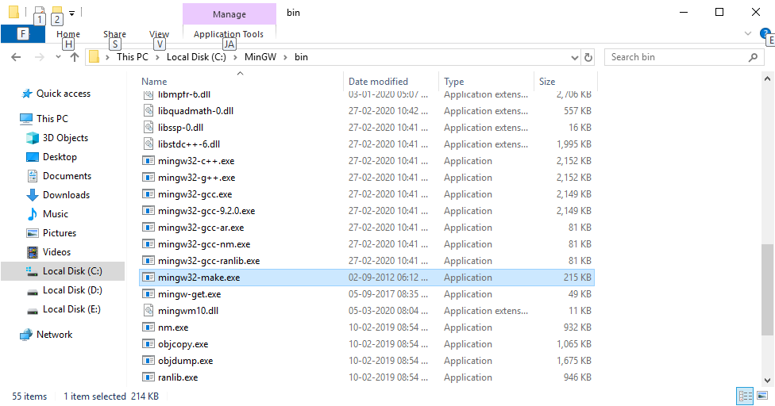
Make didn’t work directly on windows
Now you can used make command
Rename this file as make.exe

